Slide 1

Emertxe Information Technologies (P) Ltd IOT based Home Automation Solution
Submitted to : JAYALAXMI N.DHANYAL
Submitted By : R JAI KRISHNA
Final year students of Anil Neeurkonda Institute of technology and science- Visakhapatnam

Slide 2
Contents
Introduction of learnt concepts
IOT ARCHITECTURE
TOOLS USED
REQUIREMENTS
Project
Overview
Objective
Design Elements
Simulation
Conclusion

Slide 3
IOT ARCHITECTURE :
IOT architecture diagram:
DEVICE / NODE
IOT CLOUD
IOT GATEWAY
DEVICE

Slide 4
Tools used:
Arduino IDE
Picsim lab
Blynk software in laptop
Blink IoT app in mobile
Null emulator
Requirements:
Skills required to build and IOT applications:
Device programming- embedded systems development skills
C / C++,Python….
Microcontroller programming
Communication protocols
On board communication protocols-(I2C,UART,SPI…..)
IOT based communication protocols- (MQTT,HTTP,COAP…..)

Slide 5
What we have discussed in this internship:
What is SDLC?
Software / system development life cycle which is used to follow the industry way of building projects
SDLC is a software development process we follow certain phase or steps
Where it is C used?
System software development
Embedded software development
Cs kernel development
Filmware, middleware and driver development
File system development
It is a general purpose language even though it is applied and used effectively in various specific domains
In this library facilities play an important role
It is free- formatted language

Slide 6
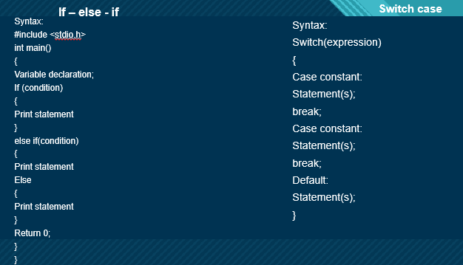
Conditional constructs

Slide 7
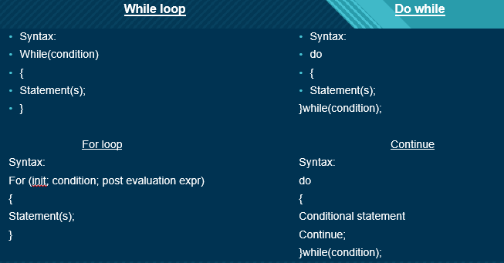
CONDITIONAL CONSTRUCTS

Slide 8
Embedded c operators
Advanced C-operators
Symbols that instructs the compiler to perform specific arithmic or logical operation on operands
All c operators do 2 things
- operates on its operands
- Returns a value
Associativity property: left to right or right to left
Multiplication & division : left to right
Add & sub : Right to left or associativity works
Logical not : Right to left
Logical AND : left to right
Logical OR : left to right
Bitwise operators perform operations on bits
The operand type shall be integral
Return type is integral value
Bitwise AND Bitwise OR Bitwise XOR
A B O/P A B O/P A B O/P
0 0 0 0 0 0 0 0 0
0 1 0 0 1 1 0 1 1
1 0 0 1 0 1 1 0 1
1 1 1 1 1 1 1 1 0

Slide 9
Number Systems :
Decimal number system : 0 to 9
Hexadecimal number system : 0 to F
Octal number system : 0 to 7
Binary number system : 0 or 1
Logical operators output is always 0 or 1
Bitwise operators output is anything i.e it can be value 12,10 etc..,
Left shift operation
Right shift operation
Operators – Ternary
Syntax:
Condition?Expression1:expression 2;

Slide 10
Over flow and underflow:
8 bits integral types can hold certain range of values
So what happens when we try to transverse this boundary?
Underflow : -128 to -1
Overflow : 127 to 0
+ve means 0 to 127
-ve means -128 to -1
Arrays :
Collection of data of same data type of elements
Syntax:
Data_type name[size];
Pointers:
Variable which stores the address of another variable
Int* : integer pointer
Char* : character pointer
Float* : float pointer and double* : double pointer

Slide 11
7 rules in pointers :
1.pointer is an integer
2. Referencing and dereferencing
3.Pointing means containing
4.Pointer type
5.Pointer arithmetic
6.Pointer to nothing / null pointer
7.Static vs dynamic allocation
Pointing containing 2 types:
Little Endian
Big Endian
There are two types of functions:
1.Inbuilt functions
2.User defined functions

Slide 12
3 types of user defined functions:
1.Function declaration / prototype signature
2.function definition / body
3.function call
There are two types
Pass by value
Pass by reference
Functions – Recursive :
Recursion is the process of repeating items in a self – similar way
In programming a function calling itself is called as function
Strings:
A set of things tied or threaded together on a thin cord
Contiguous sequence of characters

Slide 13
Class Access modifiers of 3 types :
Private : This is the default access behaviour.Accessed only by the functions inside the class
Public: can be accessed by all members even by other classes too
Protected :In this information is protected
Class constructors:
Constructor is a special member function of a class that initializes the object of the class
The compiler generates the code such a way that when an object is created a constructor is called
Constructors don’t have return type
Constructors are of 3 types:
1.Default constructor
2.Parametrized constructor
3.Copy constructor

Slide 14
Class destructors:
C++ destructor is a special member function that is executed automatically . When an object goes out of the scope or no longer needed
Pillars of oops:
Encapsulation
Abstraction
Inheritance
Polymorphism
Encapsulation: it is the process of binding the data & functions together in a single string
Abstraction : show only relevant data & hide unnecessary details of an object from the user
Inheritance :it is process of creating a new class from an existing class
Polymorphism : poly + morphism
Exception handling :
An exception is a problem that arises during the execution a program. A c++ exception is a response that arises while a program is running such as an attempt divide by zero

Slide 15
Memories :
RAM : Volatile memory – requires power supply to retain the data
ROM : Non-volatile memory – doesn’t require power supply to retain the data
OTP / EPROM : store the data into memory one time
ex: washing machine
UV / EPROM : erase the memory and store the new data
ex: research and development department
Masked Rom : Data is masked rom will never get corrupted
ex: manufacturing data
SRAM : consumes less power compare to DRAM continues power supply to retain the data
DRAM : consume more power continues power supply + extra power to refresh the data
Hybrid memory : which will be having both the memories
EEPROM: non volatile memory
ex: password for safety locker
Flash memory: two types of flash memory
1. NOR flash memory 2. NAND flash memory

Slide 16
Internet of things (IoT)
Applications:
Automobile
Manufacturing
Logistic and Transport
For Business
Examples:
Wearable Health Monitors
Smart Cars
Smart Buildings
Home Automation

Slide 17
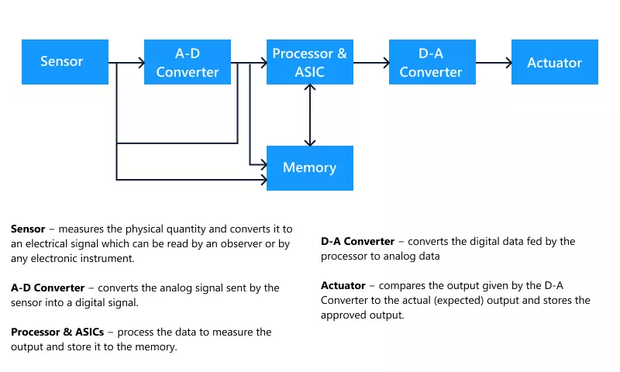
Embedded systems
A combination of computer hardware and software designed for a specific function.
They are low cost low power-consuming small computers, embedded in other mechanical or electrical devices.
Generally, they comprise a processor, power supply, memory and communication ports.

Slide 18
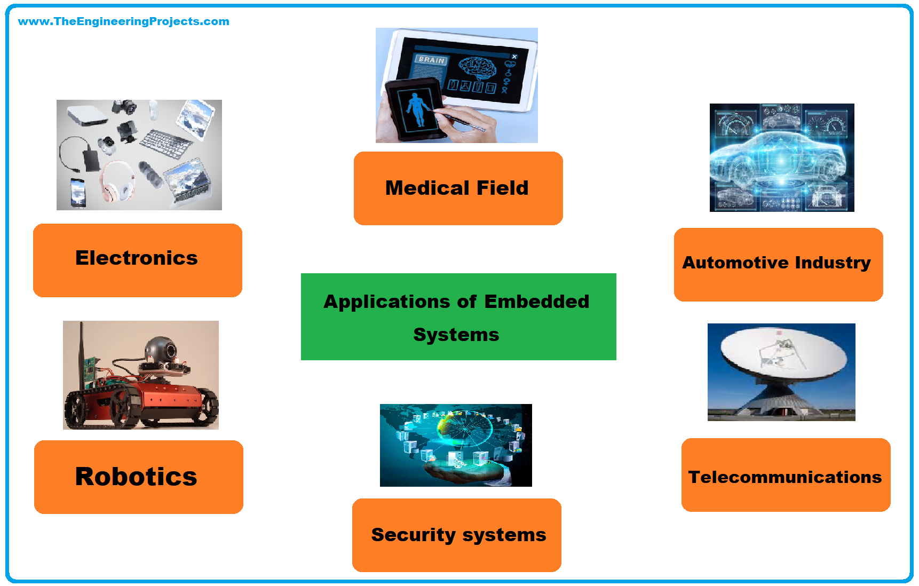
Embedded systems
Applications:
Examples:
CAT Scanners
Implanted Heart monitors
Electric vehicles
Household Appliances

Slide 19
Microcontroller
ADC block & DAC block
Timers & Counters
PWM
Processor, memory and I/O ports
Micro Processor Vs Micro Controller
RAM, ROM and its types.

Slide 20
overview
This project provides an IoT based home automation solution using Arduino UNO board in picsimlab simulator.
Blynk IoT mobile application is used to control the devices remotely.
Control the lights, temperature of the home and inflow and outflow of water in the water tank.

Slide 21
objectives
Connect the home appliances to the picsimlab simulator and integrate it with Blynk IoT app using Blynk cloud.
Control lights, temperature of home along with the level of water tank using mobile app.
Obtain notification about the status of home on the mobile phone.

Slide 22
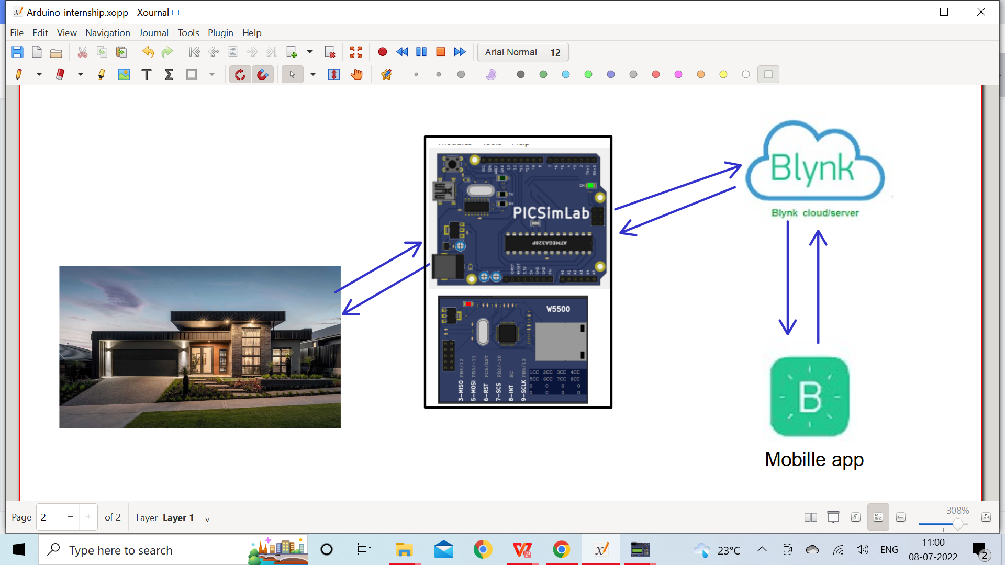
Why home automation ?
Generally people always don’t stay at home, this brings the problem of home appliances not being monitored.
The solution for this problem comes out to be home automation.
Home automation enables people to control most of the devices remotely, such as
Volume of water present in the water tank
Garden lights
Temperature of home

Slide 23
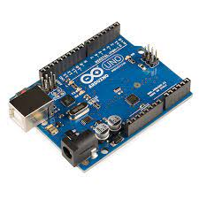
Arduino
Arduino UNO is a microcontroller board based on the ATmega328P.
It has 14 digital input/output pins (6 can be used as PWM outputs), 6 analog I/O pins, a 16 MHz ceramic resonator, a USB connection, a power jack, an ICSP header and a reset button.
It can be programmed using different IDE, Arduino IDE (Integrated development environment) is used in this project.
Arduino IDE supports C and C++ languages.

Slide 24
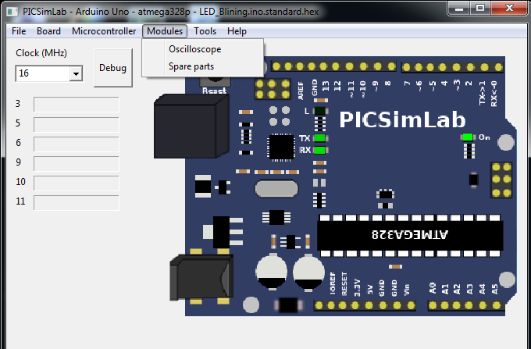
Picsimlab
Picsimlab is an open-source real-time emulator of development boards with integrated MPLABX/avr-gdb debugger.
It supports some picsim microcontrollers and some simavr microcontrollers.
It has integration with Arduino IDE for programming the board’s microcontrollers.

Slide 25
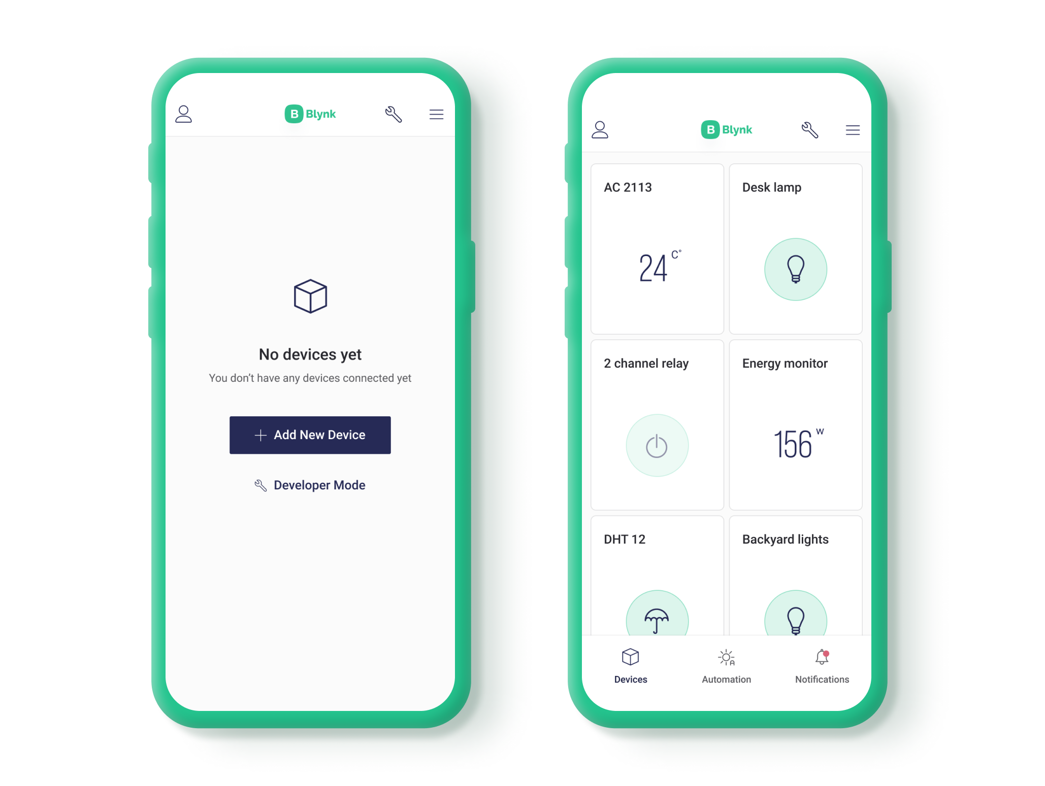
BLYNK iot APP CONFIGURATION
How to create new Template
How to add device
How to select & Add data stream
How to create icon
How to include Blynk library

Slide 26
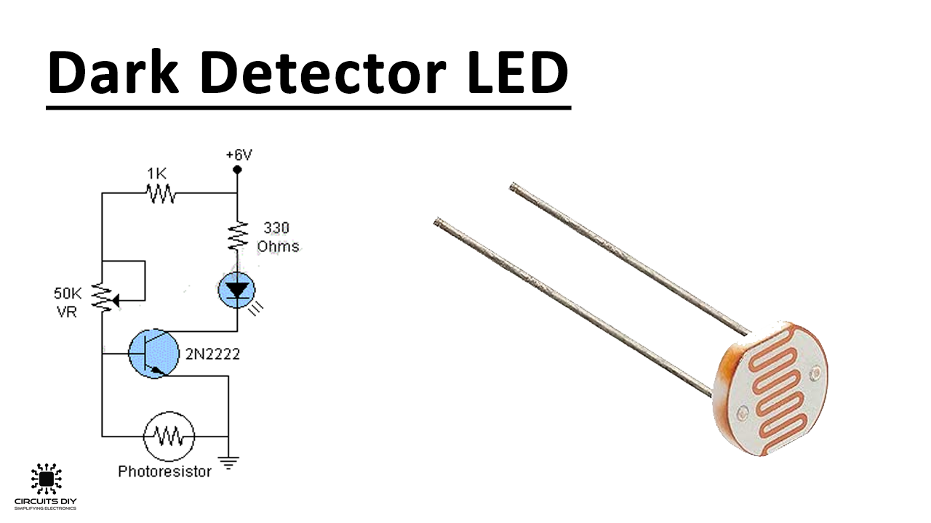
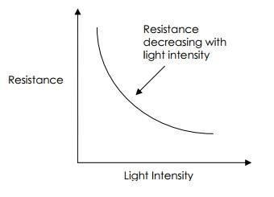
LDR (Light Dependent Resistor)
LDR sensor is a light detecting sensor that detects the light that falls upon it.
The Photo resistor is a light-controlled variable resistor. The resistance of a photoresistor decreases with increasing incident light intensity.
The LED lights are connected to the LDR via the ADC. The ADC converts the analog input by the LDR into its equivalent digital form which is then converted later by certain formula from 0 to 255 as upper bound. Based on that we glow the LED.

Slide 27
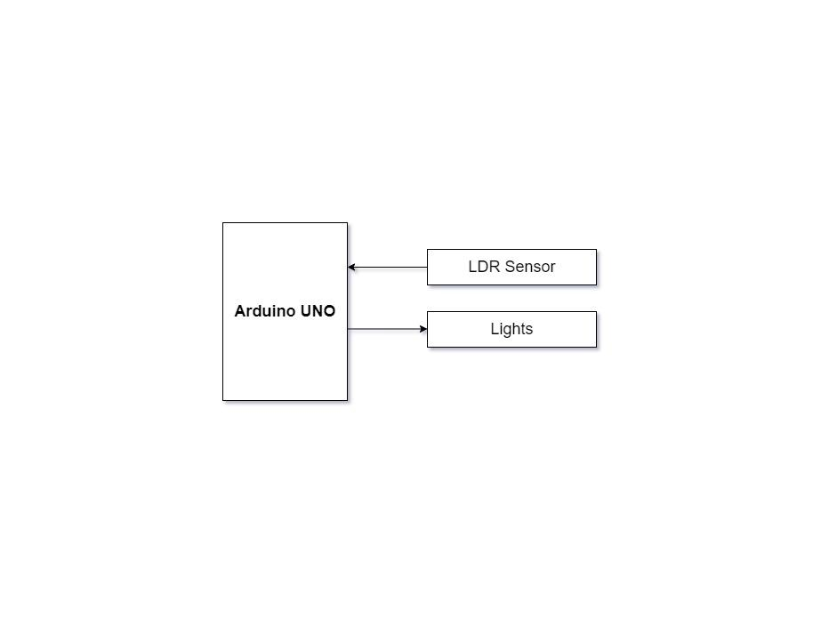
Garden Light Control
The properties of LDR sensor is applied to accomplish the controlling of garden lights.
During the day the outdoor light is maximum so the LDR sensor detects the light and the garden light is turned OFF.
Whereas at night the outdoor light is very low so the LDR sensor detects the light and the light is turned ON.

Slide 28
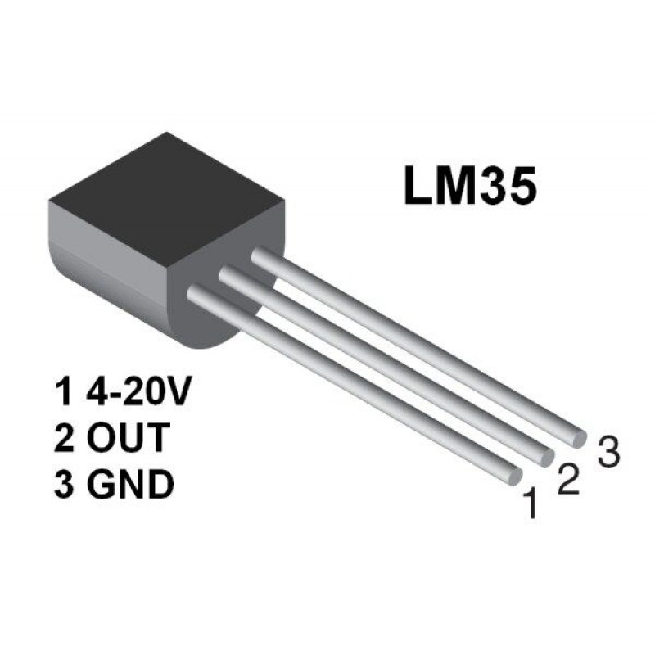
Temperature sensor
The temperature is recorded using LM35 sensor which reads analog value.
The value is converted into binary value and later actual temperature is calculated using the obtained value of the voltage.
The sensor does not require any external calibration or trimming to provide accuracies of ±0.5°C at room temperature and ±1°C over the −50°C to +155°C temperature range.
The output scale factor of the LM35 is 10 mV/°C, for instance it provides an output voltage of 250 mV at 25°C.

Slide 29
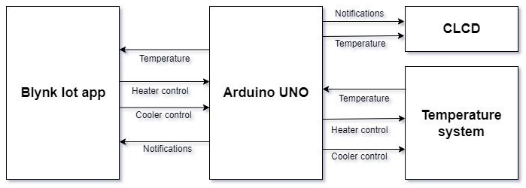
Temperature Control System
The temperature control system consists of a heating resistor, an LM35 temperature sensor, and a cooler.
Analog value of temperature is obtained from the temperature sensor LM35 and display it on the CLCD after converting it into digital value using ADC.
Control the temperature of the system by turning ON/OFF the heater and cooler through the Blynk IOT mobile app .

Slide 30
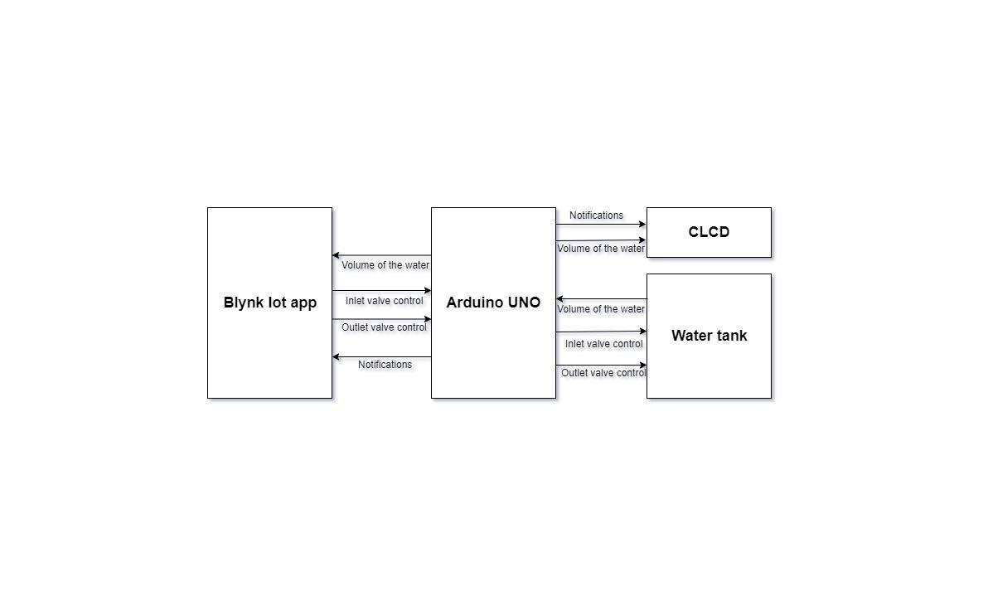
water tank inlet and outlet valve control
Read the volume of the water in the tank through Serial Communication and display it on the CLCD.
Control the volume of the water in the tank by controlling the inlet and outlet valve, by sending commands through serial communication and display the volume of water in the tank on the CLCD and also in Blynk IoT app.
The tank refills itself when the outflow exceeds the threshold of minimum value 2000 Liters and it stops filling when the tank is full at 3000 Liters gives notification to the Blynk IoT app.

Slide 31
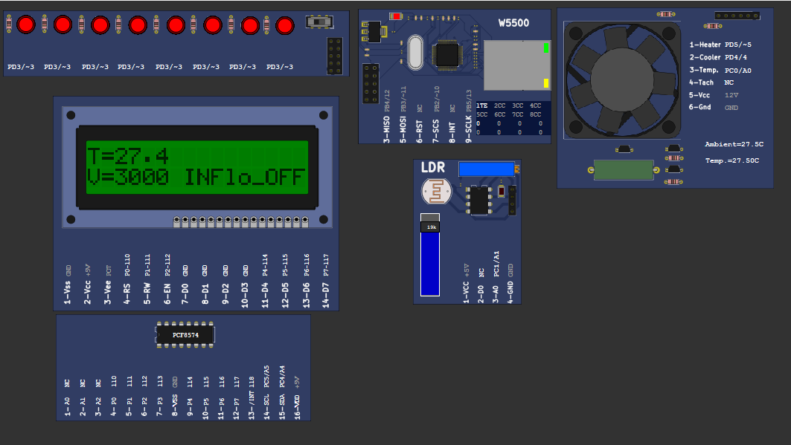
Simulation image

Slide 32
conclusion
In summary this project provides a solution of monitoring and controlling Home appliances and certain devices remotely.
Using BLYNK IoT application and Picsimlab simulator, home automation project is simulated where LED, temperature system, Serial tank resembles Light, Heater, Cooler and Water tank in real time.
Blynk IoT application allows user to control these devices according to user’s wish, thus accomplishing Home automation.

Slide 33


